Slide 1
IL2225 Project Presentation
Group 6 Jinghan Yang,Ruolan Wang,Linghan Zhao,Jiayang Wang,Xinyi Zhang,Yihang Chen

Slide 2
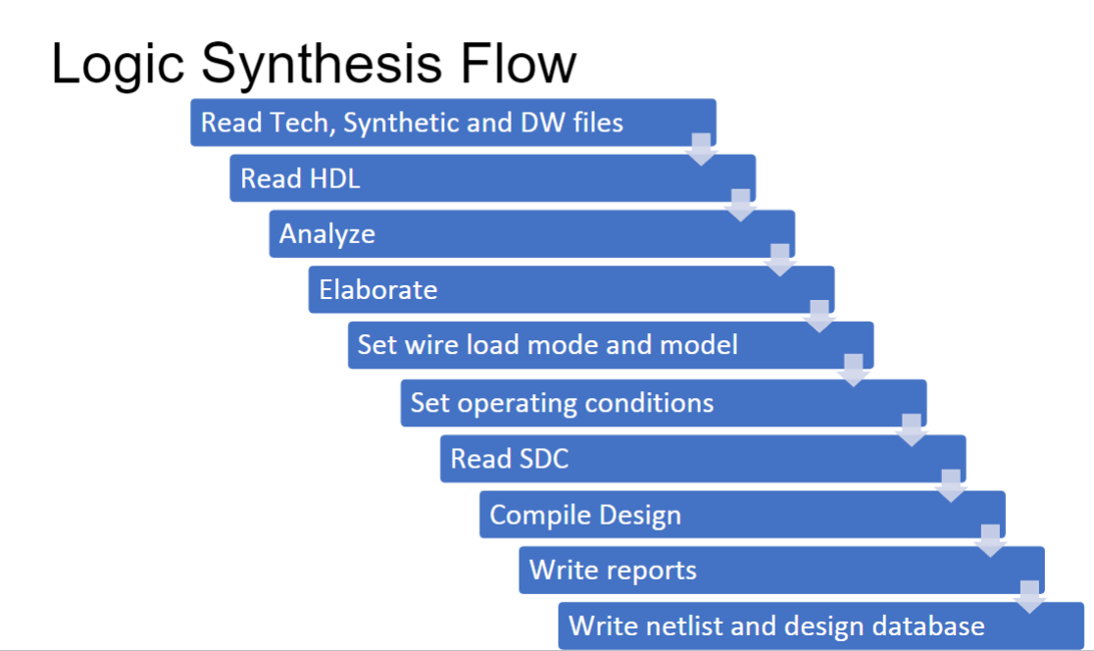
2. Flat Synthesis

Slide 3
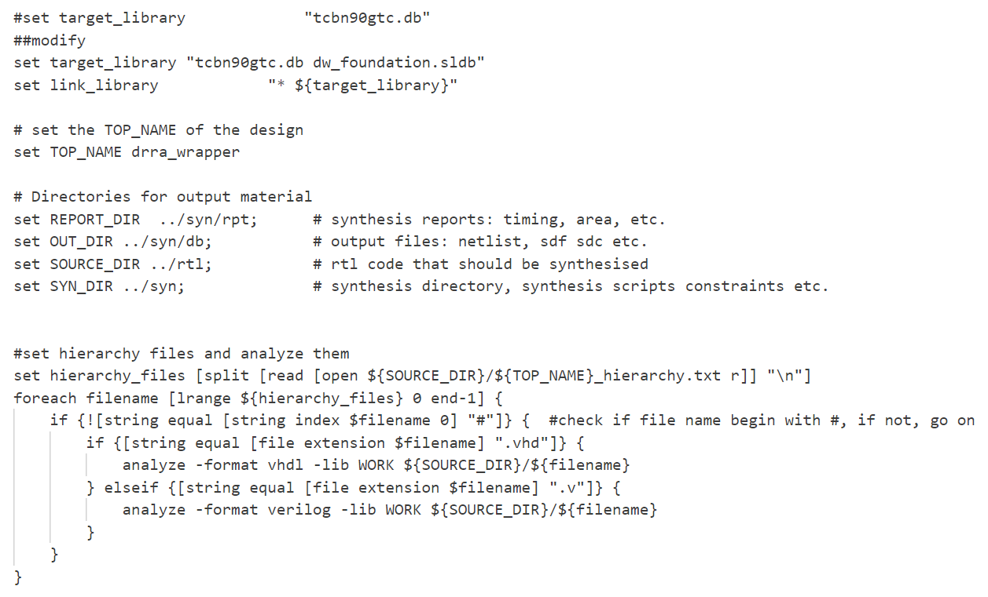
2. Flat Synthesis
Analyze
tcl:
Analyze: all the RTL syntax
Read hierarchy files
Analyze vhdl files
Analyze verilog files

Slide 4
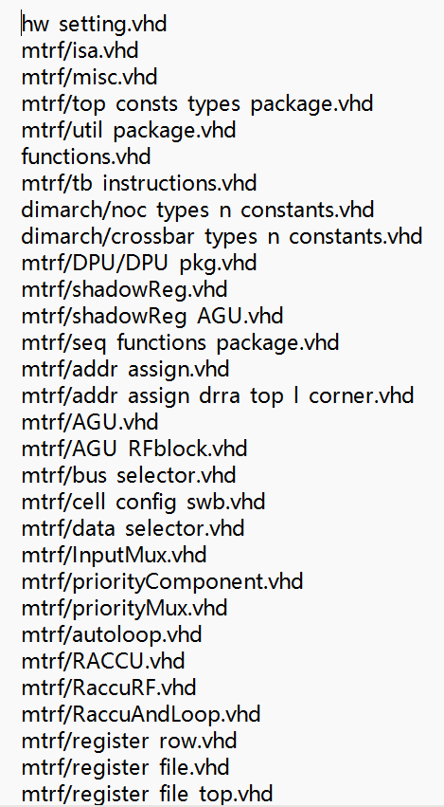
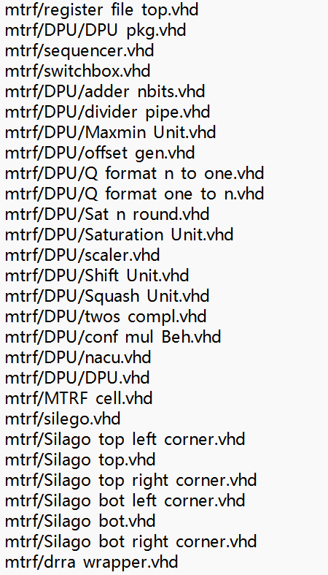
Analyze
tcl:
Drra hierarchy
TOP: drra_wrapper

Slide 5
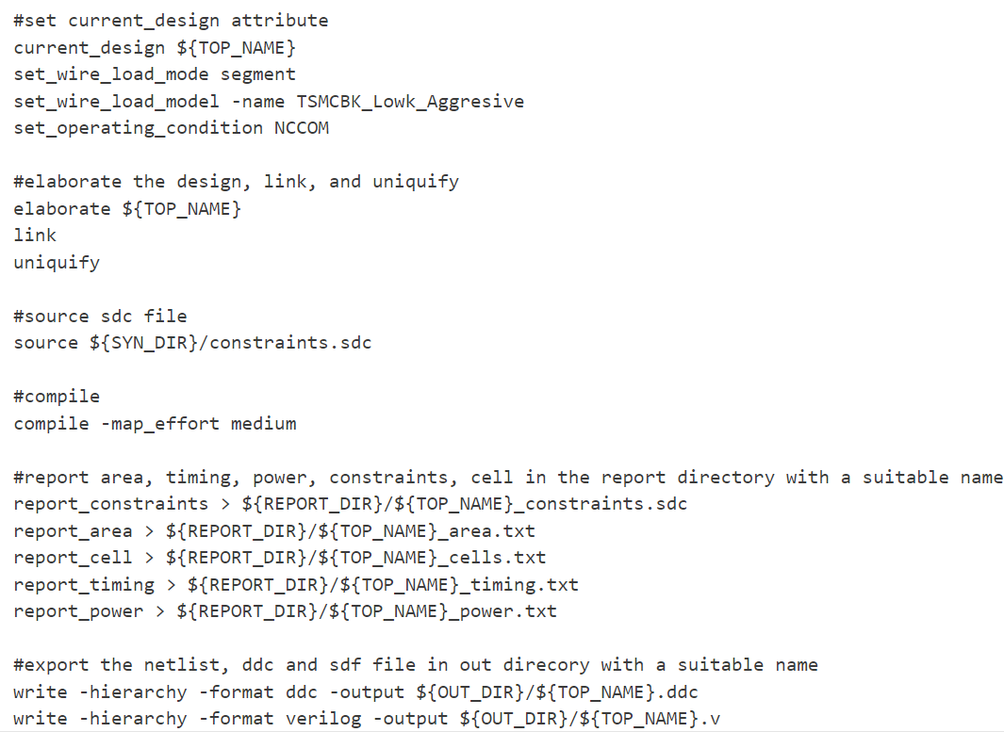
Set wire load mode
tcl:
Set the design you want to elaborate as ‘current design’
The tool adds the delays from each net segment to get the total net delay

Slide 6
Elaborate
tcl:
Elaborate: build GTECH models for the specified ‘top’ and its sub-designs
Link the specified ‘top’ and its sub-designs

Slide 7
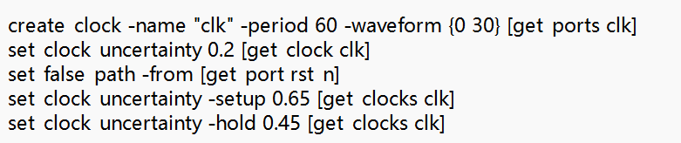
Read SDC
tcl:
SDC: constraints files

Slide 8
Compile
tcl:
Compile: map the design to technology based cells
Do optimizations

Slide 9
Write reports
tcl:
Reports are in the file: syn/rpt
Name: drra_wrapper_area

Slide 10
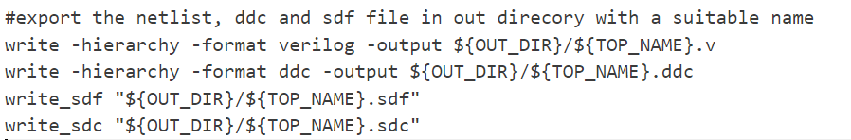
Write netlist
tcl:
Netlist files (.v)are in syn/db
Similar to sdc, constraints
sequential

Slide 11
Outcome:
timing
Clk period | 60 | 50 | 40 | 30 | 20
slack | 46.46 | 36.39 | 26.39 | 16.39 | 6.23

Slide 12
Outcome:
power
Clk period | 60 | 50 | 40 | 30 | 20
Total power mW | 24.4621 | 25.4320 | 30.4066 | 30.3686 | 31.2034

Slide 13
Outcome:
area
Clk period | 60 | 50 | 40 | 30 | 20
Total cell area | 3441040.282077 | 3441040.282081 | 3440950.771680 | 3440950.771680 | 3440950.77199

Slide 14
Outcome:
cells
Clk period | 60 | 50 | 40 | 30 | 20
cell numbers | 16 | 16 | 16 | 16 | 16

